Slide 1
Problem solving Assessment 1
Group 34​
By Emmet Noman, Dylan Hamilton, Luca Catherall-Davis, Tavis Stringer, Svens Miljons

Slide 2
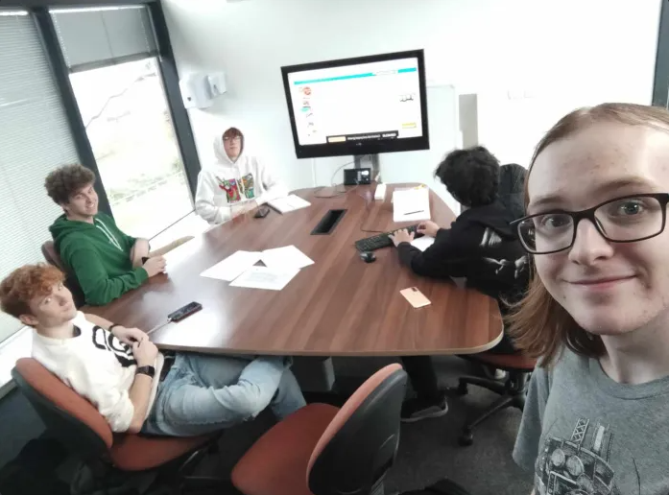
Introduction
Problem characteristics
Problem conditions
Problem classification
Types of knowledge
Decomposition
Abstraction
Gaining knowledge
Problem modelling

Slide 3
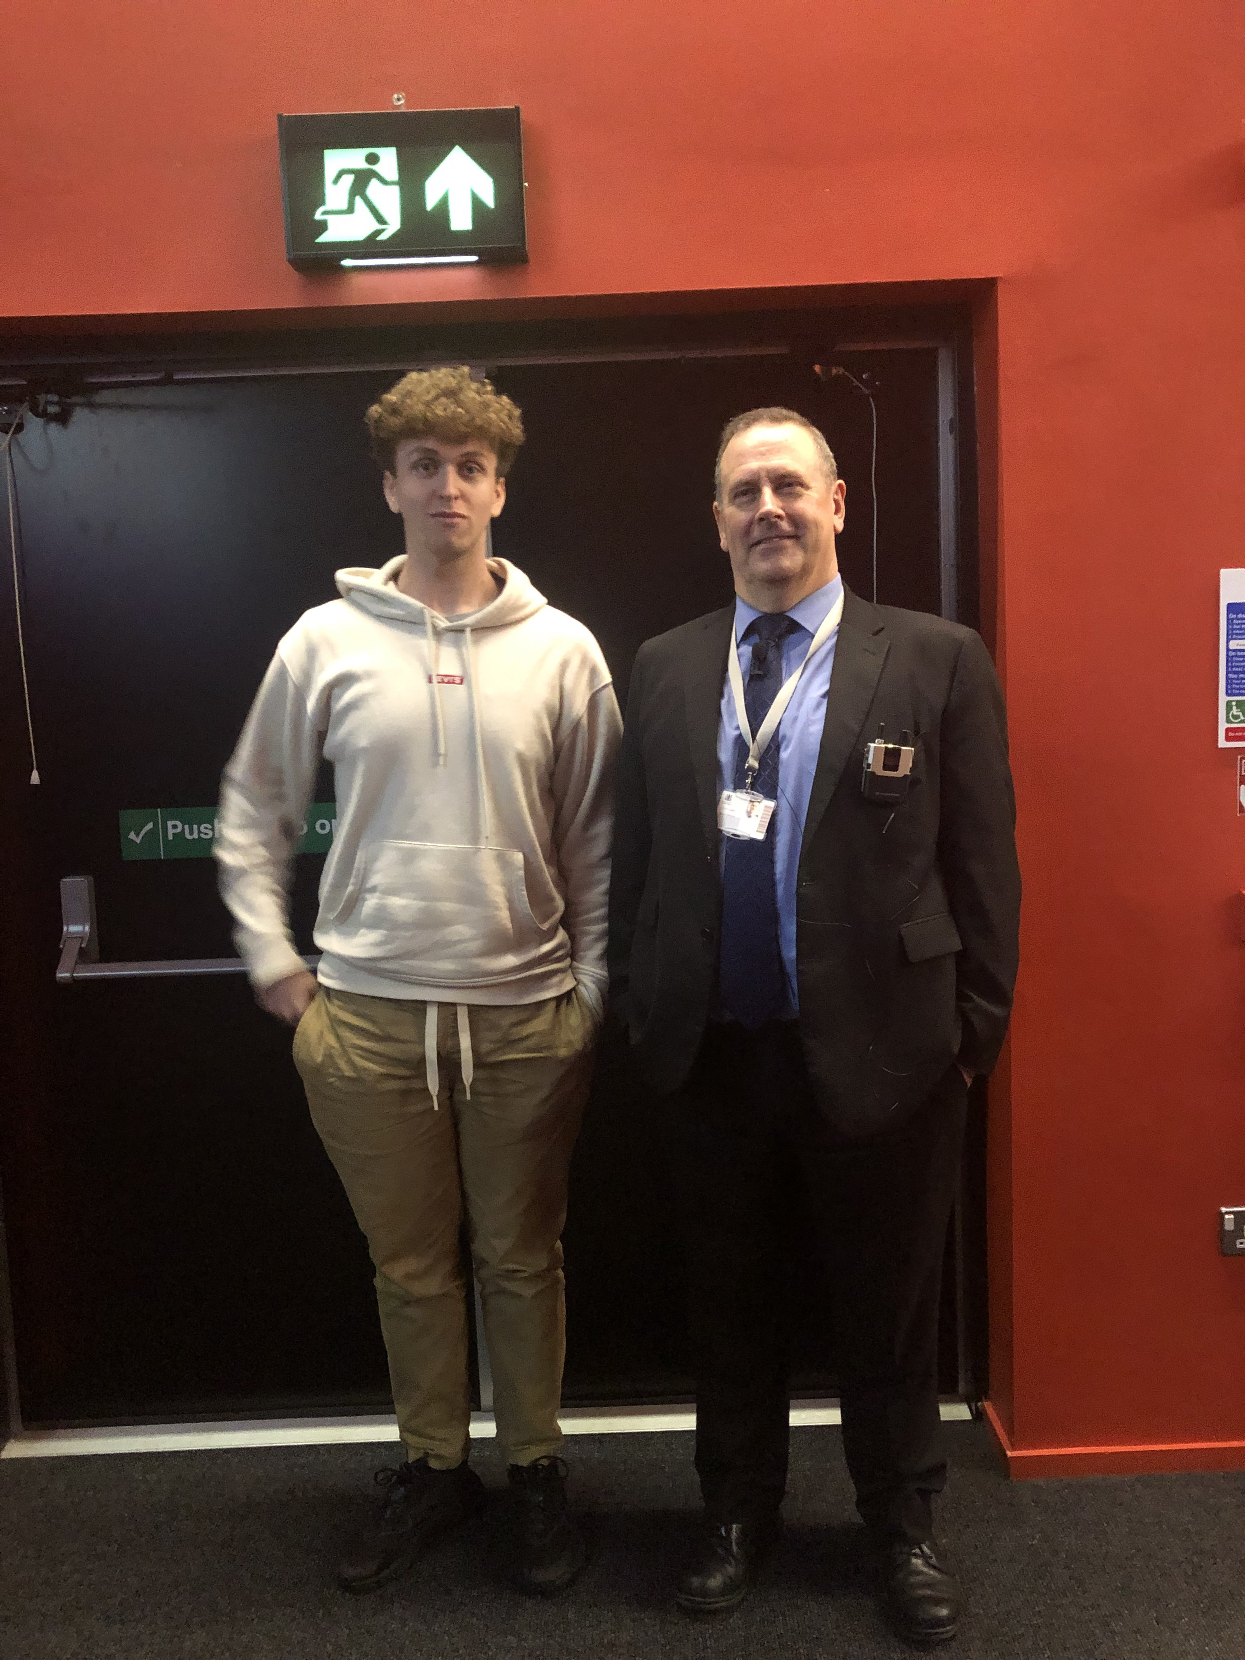
Clue 1
How we approached the problem:
Initially we were going to use Sven as a point of reference in the photo to determine the height of Kevin.
This was easy since we acquired this photo and knew Sven's height. Knowing that information we could create a trigonometric ratio to figure out the height of Kevin and find an average inside leg measurement. However...

Slide 4
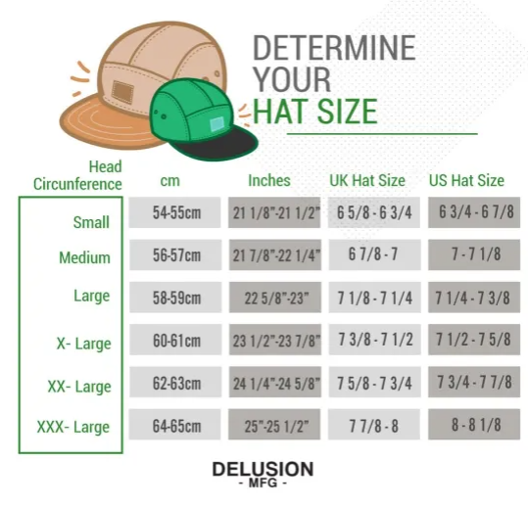
Clue 1
The answer was hidden in a lecture slide!
During the magic trick lecture there was a secret message hidden, after consulting Kevin, we confirmed that his inside leg measurement was 30cm
Answer to part 2 = 4
30 /
= 4
7.5

Slide 5
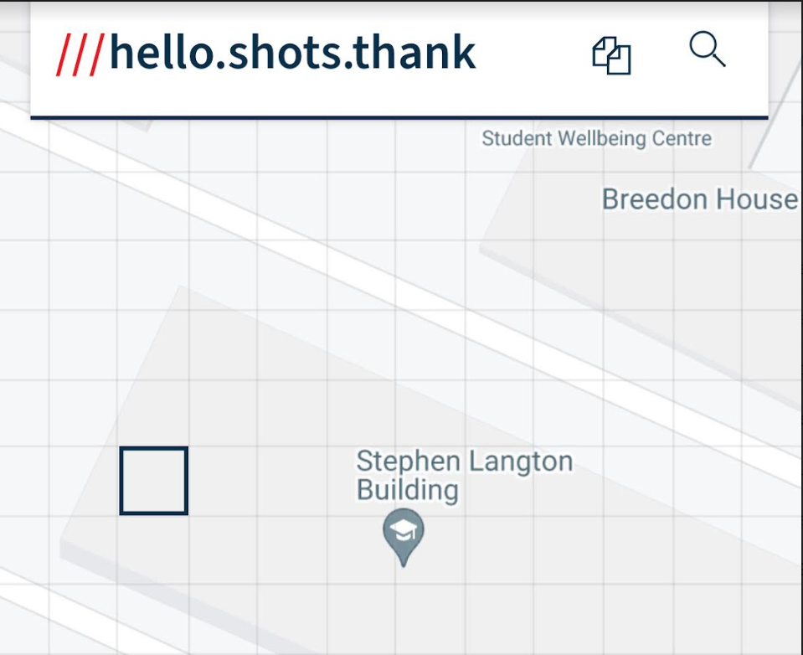
Clue 1
We noticed that these 3 words stood out in the clue as they were the only capitalised full words.
Realising this we started to investigate and eventually placed the 3 words into what3words.com which gave us the location of the Stephan Langton Building
Hello
Shots
Thank
We used the room number of our lecture hall in this building as the numerical magnitude, which gave us the number 6.
Using 6 as the first part in the question and 4 as the second, we concluded the answer was 64​

Slide 6
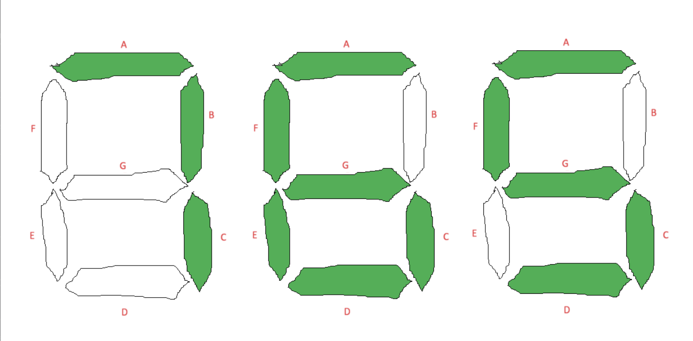
Clue 2
Intermediate States:
We tested the data from the table on a 7 diode display
We found that there is a certain standard for 7 diode displays
Initial state:
We found that Kevins most recent appellation change was to 'Doctor'
Broke problem into 2 parts
We quickly noticed LED may refer to a 7 diode LED display
A realisation from Dylan led us to find that the character counts were referring to Kevin's thesis
We also started to search for the cause of Kevin's appellation change
Outcome:
Goals:
Once we added together the character counts, we were able to put together the answer to Clue 2
After decomposing the clue, we had 3 clear objectives that we needed to progress
The first, test and confirm that we needed an LED display for the table of data
The second, find the change of appellation and therefore the cause of it
765 ÷ 45 = 17
Finally, finding out what was meant by the 'sum of character counts' section of the clue

Slide 7
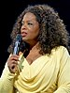
Clue 3
The Sequence
A clear goal for this problem is to find what the missing part, the 10th element of the sequence is, as it is required to solve later parts of this clue.
We decomposed this problem into three parts, the sequence, the mathematical component & an abstract component.
“Sequence A = Nobody, Nobody, Mayer, Nobody, Lansing, Nobody, Lewis, Nobody, Nobody, __________ ”
The Initial state of this part of the clue was that it was mostly ill-defined, other than there being a sequence. It had no pattern or much information that could immediately help to give the answer to this clue.
Oprah Winfrey
In the intermediate stage of solving this clue, we found that there was a Wikipedia article on “Jean Hersholt Humanitarian Award” where there were last names which matched names from the sequence. Every year someone got a reward their name was in the list with respect to the year of the award. If no one got the award, it was listed as “nobody” in the sequence.
This gave us a clear outcome of this part of the clue, since Oprah Winfrey won the award on the year of the 10th element, 2011. Marking the goal complete.
There was a suggestion that this could be a mathematical sequence such as the Fibonacci sequence. Or pascal’s triangle.

Slide 8
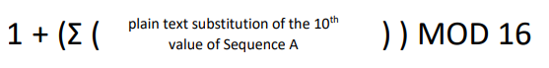
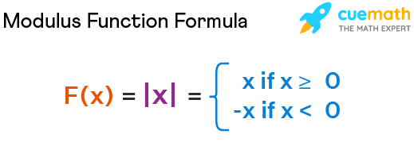
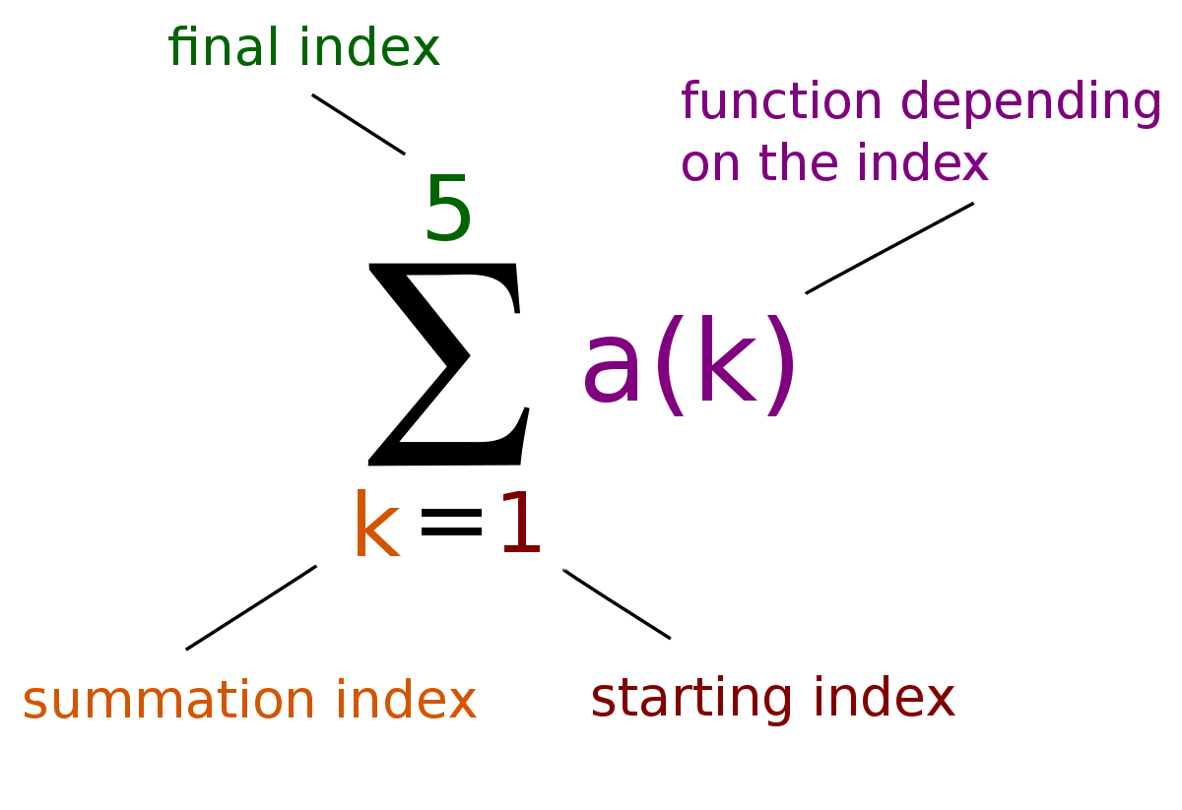
Clue 3
The Summation.
A first clear goal for this part of the clue is to find the answer to the given equation, as that would simplify the process moving forward.
For this we need the 10th plain text substitution of sequence A, which would be Winfrey.
This brings us to our second goal, find what the “plain text substitution” would be of Winfrey.
Afterwards, we need to evaluate the entire line, which we expect to have a single number as its outcome.
“ ”
The Initial state of this part of the clue was that it was mostly well-defined, since it was a mathematical equation, although it included some non-standard ways of having variables, as you usually only have letters, this one had a reference to the 10th element from the sequence we analysed earlier, completing the first goal. Which was in the form of text, for which we could think of multiple ways to convert into numerical format.
Modulus piece-wise representation.
In the intermediate stage of solving this clue, we recalled from one of kevin’s lectures he briefly discussed plain text and the A1Z26 substitution.
Substituting each letter for its number representation, we get “23, 9, 14, 6, 18, 5, 25”. Now adding these together, as asked from the summation, we get 100. This is a nice round number, so we are confident that this is the correct outcome. Marking the second goal completed.
Using this information, we can evaluate the entire line to be 1 + 100 MOD 16
Using BIDMAS, PEMDAS, BODMAS, whatever, we know to do MOD first, giving the result to be 5. Achieving our last goal with the expected outcome.

Slide 9
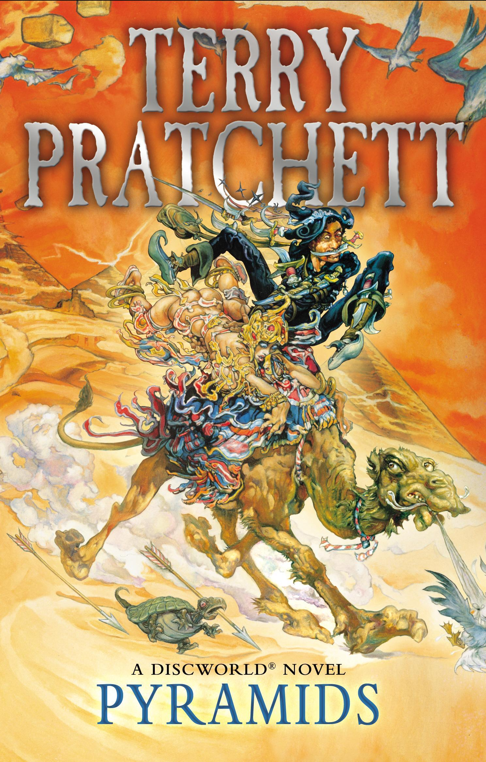
Clue 3
The Abstract Component.
This could be decomposed into multiple parts, the first part being the numerical representation of “the series position of pyramids…” which is our first goal, then multiplying that by the previous summation, our second goal.
“[The Summation] Multiplied by:
the series position of Pyramids less half the number of elephants that hold them (and
everything else) up.”
Initially, the wording of this is very confusing, as they are not clear. “Pyramids less half” are three words that do not make much sense together, and it does not explain what “everything else” is. So it is seen as Ill-defined.
Discworld “Pyramids”
In the intermediate stage of solving this component of the clue, Dylan mentioned a “Discworld” book called “Pyramids” Which seemed to be a viable lead, so we followed it. In the book there are 7 pyramids, and “less” was assumed to mean minus, and halving the number of elephants, of which there are 4, gives us the equation 7-2, which evaluates to 5.
Checking back, we have only one goal remaining, which it to multiply this by the previous 5, getting 25. Which marks all goals as complete.
Part 3 slides laid out by Emmet, the information on this clue was supplied by the Dylan, more Dylan, the entire group, google & Wikipedia.

Slide 10
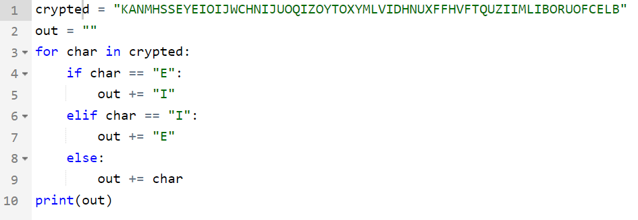
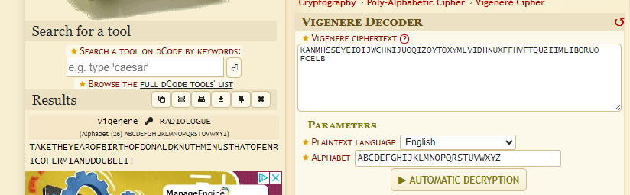
Clue 4
At first we thought of just de-cyphering the test by using the most used characters and swapping them.
To find the second part, Dylan went to Kevin's office to find the dali inspired device, which was the molten clock. The two pointers pointed at the same place so meaning that its degrees were 0.
We used Radiologue as the key and got
"TAKE THE YEAR OF BIRTH OF DONALD KNUTH MINUS THAT OF ENRICO FERMI AND DOUBLE IT"
We first looked at the keywords in the clue, those being 911 and Fifth Element at the time
After looking more and finding no leads we gathered that the clue was a response to 9/11 not the number 911.
The word disconnected made us question if it was a band member leaving a band.
After searching for a relation to disconnected a music, we found an album, "Disconnected – Fates Warning"
Made us think that "Fifth element" meant fifth song of the third album.
The band member that "Disconnected" was their guitarist "Jim Matheos", who made a new band "OSI"
There is an album called Blood, which made us believe that meant the fifth element meant fifth of that album which was the song Radiologue.
Turns out it was the key to solve the line of letters.
1938 - 1901 = 37 * 2 = 74
74 – 0 = 74!

Slide 11
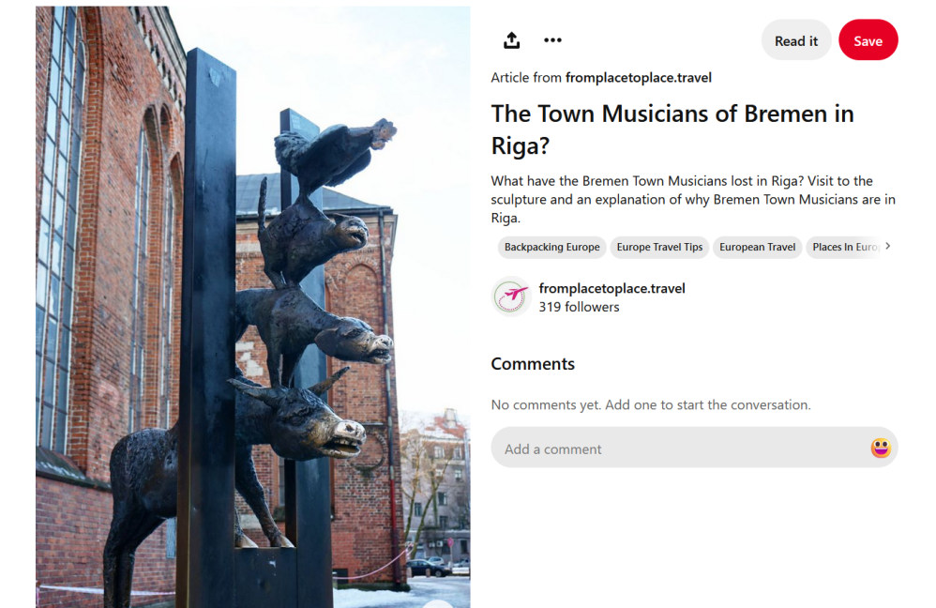
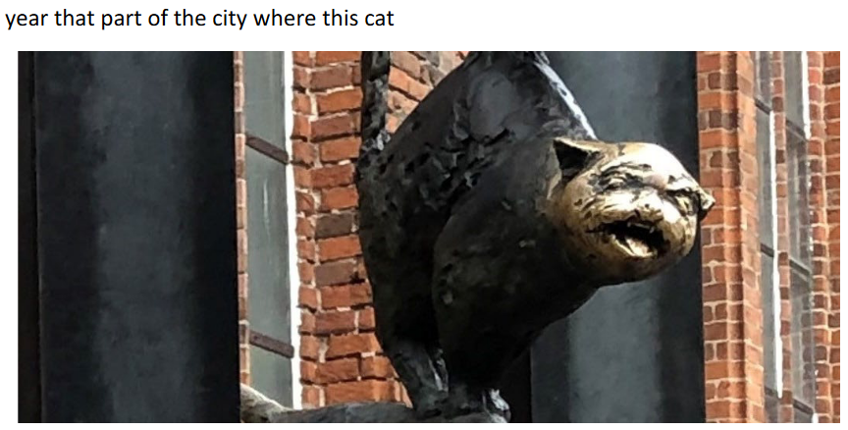

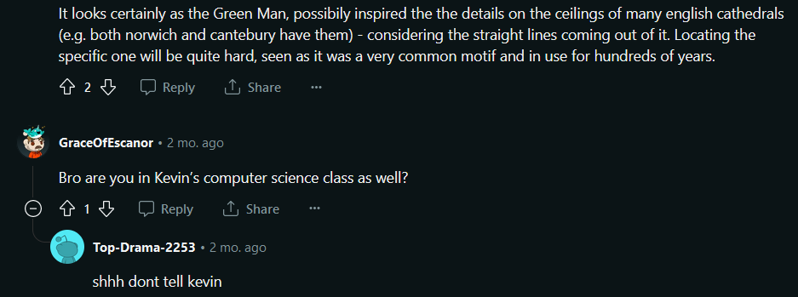
Clue 5
The city the cat was from only requires a reverse image search. It’s Riga in Latvia, which has it’s historic centre UNESCO’d in 1997!
For the second image, a reverse image search took us to a “Reddit” post by likely another Problem Solving group. The Reddit people felt it was the “Green Man”
I was thinking it sort of looked like Aslan from Narnia, and on Week 5 overheard someone complaining to Kevin that there wasn’t a source for C.S. Lewis knowing Green Man, then was certain. (Is this cultural knowledge gathering?)
1997 – 1898 = 99 / 3 = 33

Slide 12
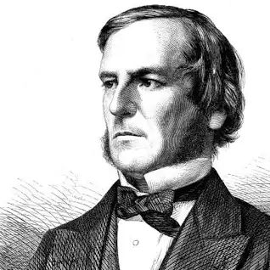
Clue 6
The problem
Upon closer inspection, It appeared that the problem had already decomposed into parts labelled as a, b, c, and d, each representing seemingly independent questions with numerical significance as they involve one or more mathematical features.
After these parts, there was “Square and add the siblings version of M45.”
Which was also a mathematical question as it had “square” and “add” which are well defined instructions. “Sister version of M45” was the part which was ill defined as none of us had immediate ideas.
“If Boole wrote the answers to these questions, what number might he SAY was their combination?...”
Initially, from personal experience we knew George Boole is the inventor of “Booleans” a value that can only be true or false. This gave us a lead to what kind of outcomes the following parts of this clue may be. We thought this way as the problem has “SAY” in capital letters. Hinting that we should be looking for Boolean answers.
George Boole
After the Boolean questions, our goal was set to solve the mystery “Siblings version of M45.”. This was initially ill-defined to most of us as in our intermediate stage, we considered that M45 could have been the name of a highway, and siblings could be the number of highways that are connected to that highway. Another option was that it was the constellation “Messier 45” which is known by the alias “Seven Sisters” as it has 7 prominent stars. The latter approach seemed very likely and so we went with 7 as the numerical representation of the “siblings version of M45” to perform calculations with.
Break down on parts a, b, c and d are on the next slide as they are their own problems.

Slide 13
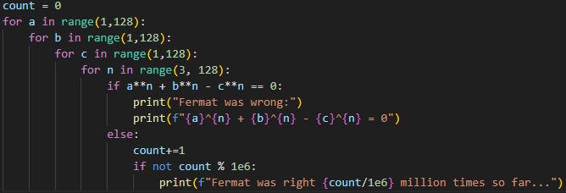
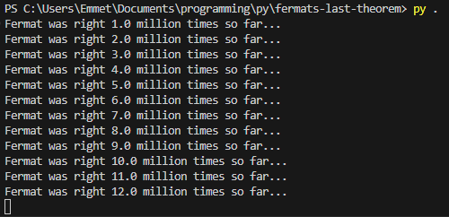
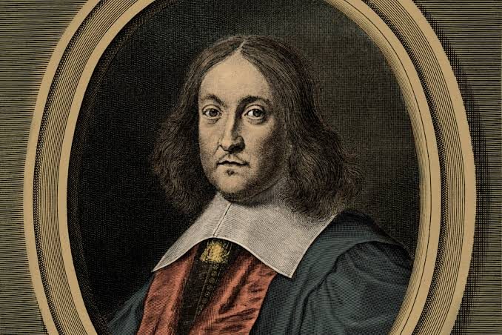
Clue 6a
Part A
Emmet’s test program to try and disprove the mathematical statement.
“For each integer n where n > 2; the equation a^{n} + b^{n} = c^{n} has no non-zero integer solutions a, b and c. True or False?”
Initial state of this clue was that it was very well defined, as it was a mathematical equation with a definite answer. As all of us had prior experience in mathematics.
Pierre de Fermat
While brainstorming we produced the idea of writing a program to solve this problem. This could not fully prove by exhaustion as it had an infinite amount of cases and we lacked the resources, time or money to do infinite computations. Although our efforts brought us closer to the answer.
Googling the problem brought us to a Wikipedia article on Fermat’s last theorem and upon studying the page, it was confirmed to have been proven true. This gave us enough evidence to consider this part to be resolved to “TRUE” or “1”.
Prior to googling, we used a brute forcing method to check 264,241,152 different permutations of a, b, c & n together. This was to see if the program was going to find contradictions to the statement, which it failed to disprove the statement. This pointed towards this statement being true.

Slide 14
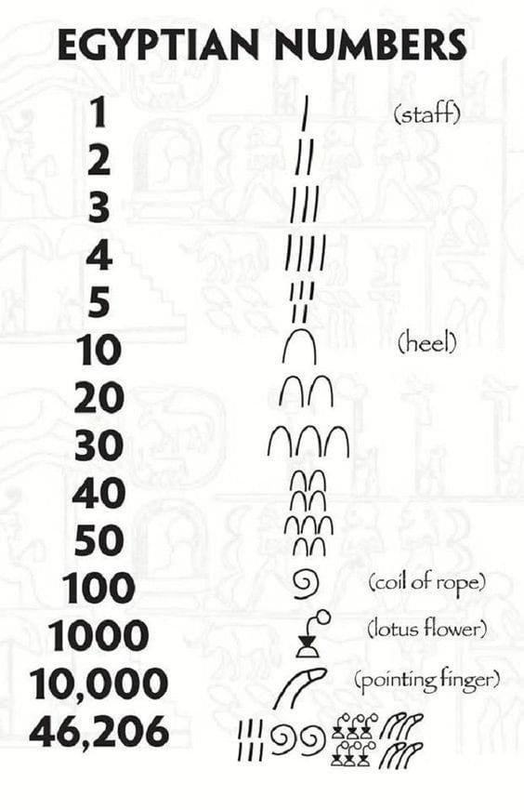
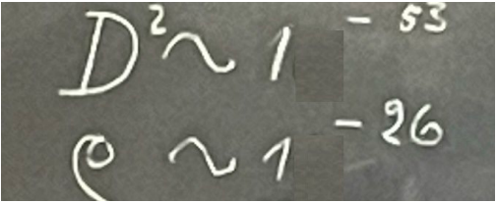
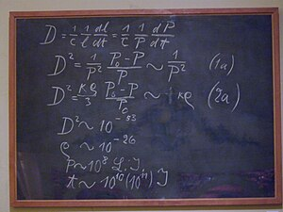




Clue 6B
Part B
Ancient Egyptian counting system.
“The sum of what is missing from this picture”
Initial state of this clue was that it was clearly using indices and letters that are used in mathematics, like D and the spiral (100) being an ancient way of counting numbers.
Einstein’s blackboard
We saw this question and Emmet saw it as two very small numbers written in scientific notation, and the base of the power is usually 10, making the hidden digit a couple of 0’s.
This already gave us enough evidence to consider this part to be resolved to “FALSE” or “0”. But being curious about this board, we put in the numbers on google and it went to a Wikipedia article about einstein’s blackboard, and we came to find that the image used in the clue is a snippet from the Wikipedia image. This confirmed the answer being 0 for this part of the clue.
Wikipedia says that D²~10⁻⁵³ is the Hubble constant, and the spiral image underneath is a Greek letter, ρ pronounced “rho” which we mistook for an ancient Egyptian coil of rope symbol.

Slide 15

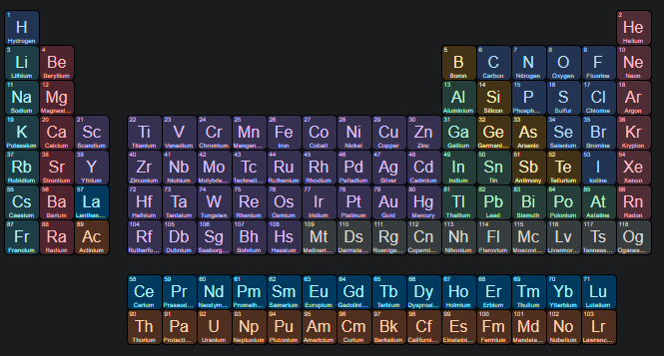
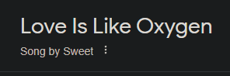



Clue 6C
Part C
This problem was decomposed into multiple parts, our goals being:
- find a numerical representation of the “numerical epithet”.
- find a numerical representation of “the atomic number of what compared to love for andy”
- subtract second part from first part
Then we considered that “The atomic number” is related to chemistry, more specifically, the periodic table.
We then try to combine an element and the second part, which seemed like a song and produced “Love over gold” by Dive Straits and “Love is like oxygen” by the band “Sweet”.
“Laker and Lock play the perfect game against my side. We have not managed to make any impact whatsoever, making Mr Zaltzman’s job so much easier. If I alone stand unconquered what numerical epithet could you legitimately apply to me? Subtract the atomic number of what compared to love for Andy, the last surviving member of a blockbusting band.”
Laker & Lock
The guy on the right kind of looks like Kevin lol
We find that “Zaltzman” is a sports commentator, which means it is likely that we found the person from the clue. We overheard Kevin explain a perfect game of cricket, which resulted in us resolving this part of the clue to be 8. We are not sure why.
Looking further into the songs, it is found that “Sweet”’s last active member is “Andy Scott” Who shares the same first name as the person in the clue. Assuming this is the same Andy, we use oxygen and find it’s atomic number to be 8 by reading the periodic table.

Slide 16
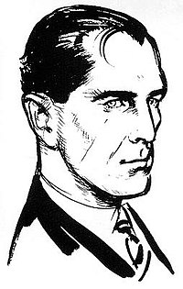



Clue 6D
Part D
The numbers kinda sus…
“DEAF minus the ‘normal version’ that is 57&Bond”
On first look, Part D looks extremely cryptic, with no clear lead to what any of the text means.
This makes this part’s Initial state somewhat ill-defined, as none of us have any immediate ideas.
Rotated to fit Wikipedia image of James Bond:
Intermediate steps: Upon further inspection, it is considered that DEAF might be a HEX representation of a decimal number, which we convert into “57007”. This leads us into thinking that 57&bond and 57007 may be linked as “James bond”, a literary character who goes by the alias 007. This leads us to think that it is as simple as subtracting 57007 from 57007 which cancel out, giving us the final part’s answer as 0!
We decompose this problem into two goals, finding out what DEAF represents, and what the “normal version” of “57&bond” may be. We find that the “normal version” would be considered the decimal representation of 57&bond. This hint also applied on the first part of the clue.

Slide 17
Clue 6
Putting everything together
In summary, these are the outcomes for clue 6: George Boole, = Boolean: a) Fermat’s last theorem is true = 1
b) 10^-52 = 0
c) 8-8 = 0
d) 57007 – 57007 = 0
1000 binary to decimal = 8
M45’s sibling number = 7
8²+7 = 71 !
Now that we have all the components of this clue, we can start piecing them together.
We have the result of the 4 parts, a, b, c and d, which we know have to be Booleans. These come out to be 1, 0, 0 & 0 respectively.
Everything’s finally coming together!
Intermediate steps: From our prior knowledge with computers, we know computers use binary to store decimal numbers, so we treat this as an unsigned 4 bit integer, which evaluates to 8. The last line tells us to square something, since this was immediately after the Boolean part, we assumed that it was 8 which needed to be squared, which turns out to be 64. now adding the “siblings version” of M45, which we know to be 7, we get 71. Which we then confirm with Kevin to be correct.
Clue 6 slides laid out by Emmet, the information on the clues was supplied by the entire group, google & Wikipedia.

Slide 18
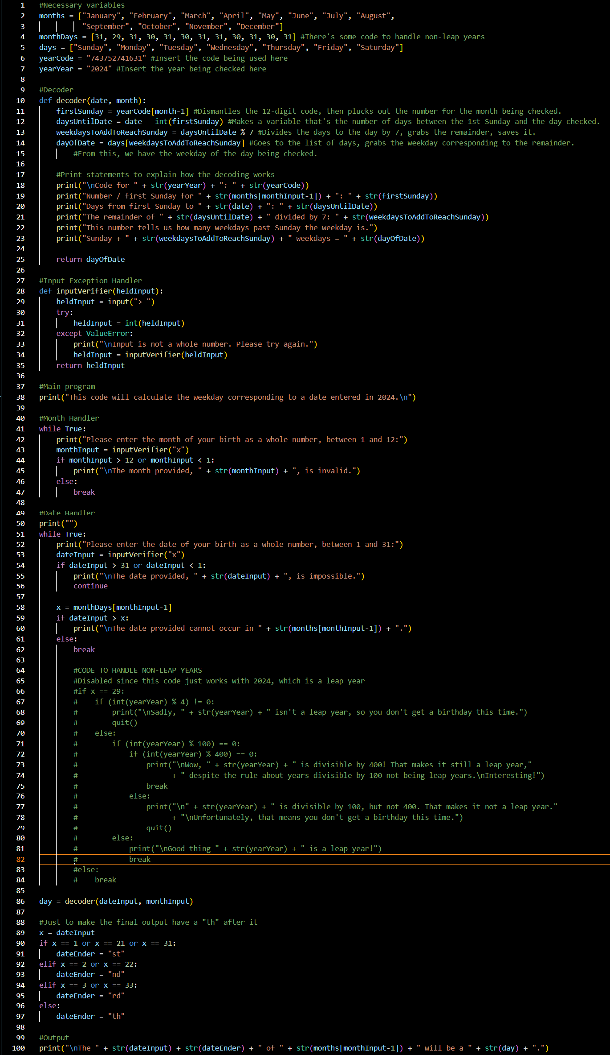
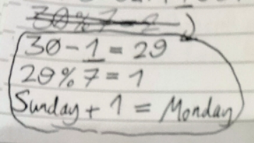
Stages 2 & 3
Discovered meaning of Stage 1’s code through cultural(?) knowledge gathering? That means looked it up on Google and saw it immediately! (First Sundays)
Started programming with a “textual” model – wrote a brief pseudocode in my notebook, asked Kevin for feedback, changed it in response
When coding, made functions to handle non-leap years and a function to add “th”s – both totally pointless! Does the job well but could be simpler

Slide 19
Any questions???

